Slide 1
Time Series Clustering of Sensor Data for Radiation Profiling
Dr. Jack K. Rasmus-Vorrath
8/7/18

Slide 2
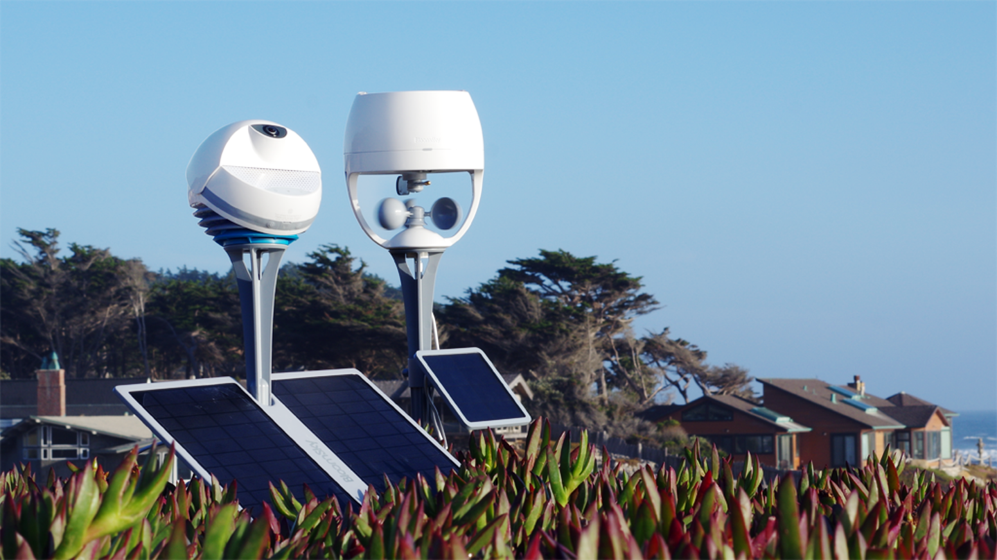
The WHY: Radiation Profiles drive Control Logic
New technologies designed to regulate exposure of interior spaces to light and heat radiation use on-site sensor data to conduct control-structured decision making in response to real-time changes in radiation levels.
Unsupervised and supervised ML can be used to develop and validate site-specific radiation profiles to inform and improve application control logic.

Slide 3
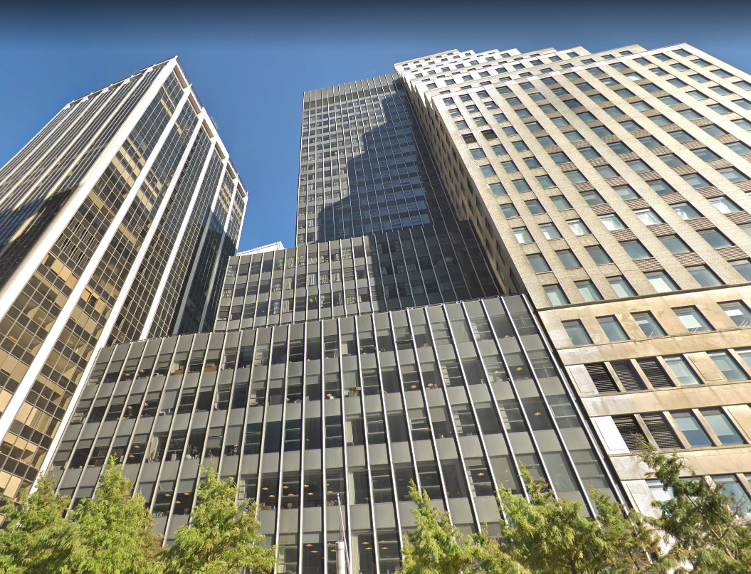
The WHAT: Data Description
245K rows of minute-level time series data
13 photo sensors spanning 7 months (August 2017 to February 2018)
Collected at a high-rise commercial building on Wall St. in NYC
Inputs: preprocessed sensor data
(raw values measured in Lux)
Outputs:
Cluster centroids (unsupervised methods)
Categorical labels (supervised methods)

Slide 4
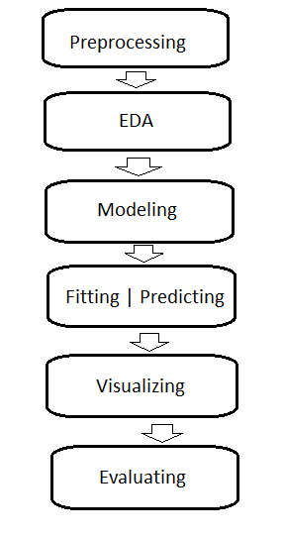
The HOW: Workflow, Algorithms, and Performance Metrics
Preprocessing:
Mean-Variance Scaling | Min-Max Scaling
Piecewise Aggregate Approximation
SMOTE | ADASYN Oversampling
Exploratory Data Analysis:
Dynamic Time-Warping (DTW) K-Means
DTW | Soft-DTW Barycenter Averaging
Supervised Algorithms:
KNN | Time Series K-Neighbors
Shapelet Classification
Metrics: Accuracy, Precision, Recall, F-1, AMI, Adjusted Rand, NMI, Homogeneity, Completeness, V-Measure
Unsupervised Algorithms:
K-Means++ | Time Series K-Means
K-Shape
LSTM Sequence-to-Sequence Autoencoder
Metrics: Inertia, Silhouette, Calinski-Harabaz
Workflow

Slide 5
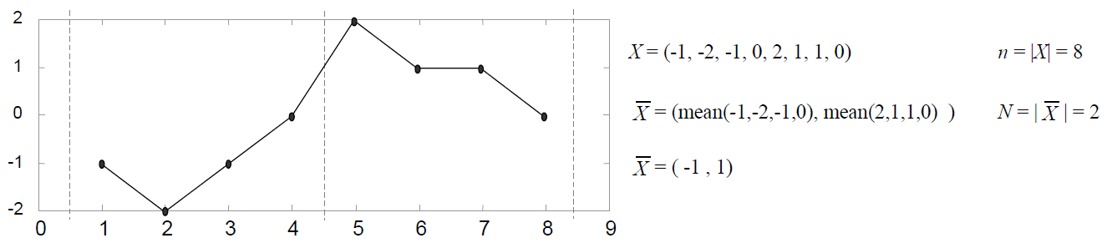
Preprocessing (1): Piecewise Aggregate Approximation
Data are first grouped by calendar date
Lux values are converted to Watts/m²
The max of 13 sensor values at each minute interval is taken (MAX drives control logic)
Night-time rows with < 1 Watt/m² are filtered out
Values are scaled from 0 to 1
The minimum row length is used as the output length for a Piecewise Aggregate Approximation (PAA)
PAA compresses the data by dividing the time series into a number of segments equal to the desired number of time steps, then replacing each segment by the mean of its data points

Slide 6
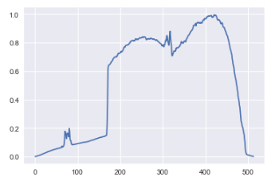
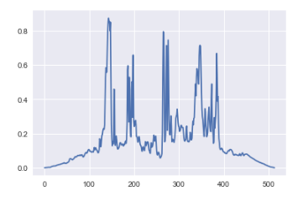
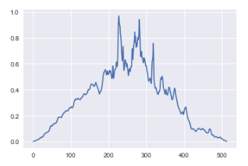
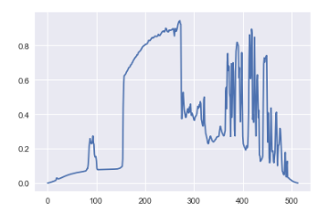
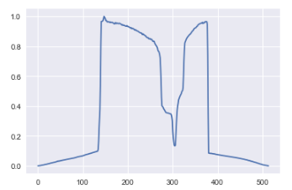
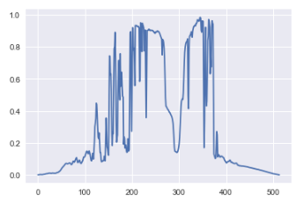
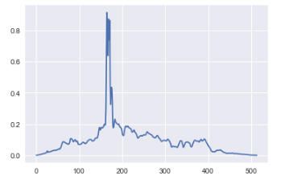
Preprocessing (2): Hand-labeling Approximate Ground Truth Classes
1
2
Preprocessing results in a data frame with 171 rows (days) and 514 columns (time-steps)
To approximate unavailable ground truth, rows are classified by hand using domain knowledge of common radiation profiles:
Sunny, (1)
Cloudy, (2)
Partially Cloudy, (3)
Mix Sunny/Partially Cloudy, (4)
Sunny with Occlusion, (5)
Partially Cloudy with Occlusion, (6)
Cloudy with Sun-spike (7)
3
4
5
6
7

Slide 7
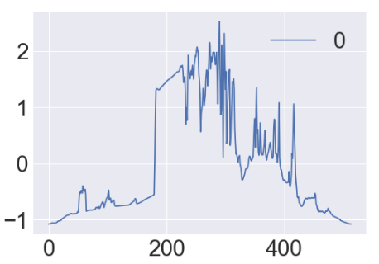
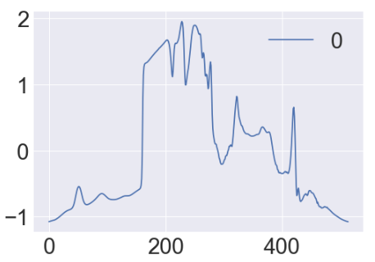
EDA: (Soft) DTW K-Means and Barycenter Averaging
Dynamic Time-Warping (DTW) is a robust distance measure for time series, allowing similar shapes to match even if the time axes are out of phase
Soft-DTW is a regularized, smoothed formulation of DTW that computes the soft-minimum of all alignment costs
In an unsupervised fashion, Barycenters find a consensus sequence from a given set of DTW-aligned sequences, facilitating convergence during K-means averaging
Weekly Barycenter averages are calculated across the 171 rows (days), in a first-pass visualization of possible cluster centroids occurring over the specified timeframe
Week 6 DTW Barycenter Average
Week 6 Soft-DTW Barycenter Average

Slide 8
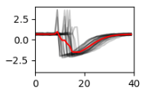
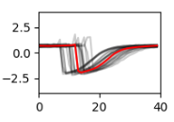
K-Means++ | TS K-Means Approach
K-Means++ uses adversarial placement of the starting centers, weighting data points according to their squared distance from the closest center already chosen
For comparison, a time-series implementation of K-Means is also applied to allow use of the (Soft-) DTW distance metric during cluster assignment and Barycenter computation
A value of K=7 was used as a baseline in exploring possible sets of cluster centroids
Euclidean K-Means++
Soft-DTW K-Means
Example from the Python TSLearn Documentation

Slide 9
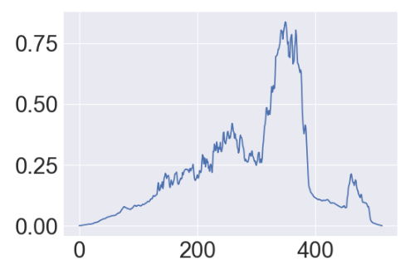
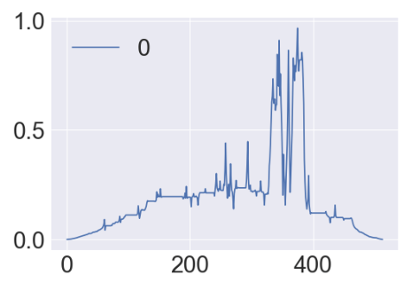
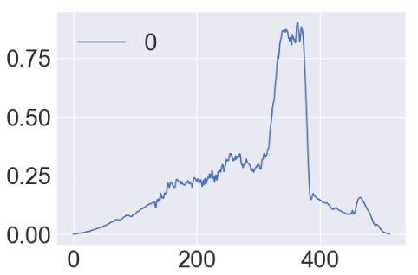
K-Means++ | TS K-Means Results
Using Euclidean, Cosine, Minkowski, DTW, and Soft-DTW metrics:
Inertia: the sum of the distances of samples to their closest cluster center
Lower is better
K-Means++: 1764.23 (Euclidean)
TS K-Means: 1.073 (DTW)
Silhouette Scores: difference between the mean intra-cluster distance and the mean nearest-cluster distance for each sample, divided by the maximum of the two
[-1, 1]: Closer to 1 is better
K-Means++: 0.22 (Minkowski)
TS K-Means: 0.19 (Soft-DTW)
Calinski-Harabaz Scores: the ratio between within-cluster and between-cluster dispersion
Higher is better
K-Means++: 42.56 (Euclidean)
TS K-Means: 41.03 (Soft-DTW)
K-Means++
TS K-Means (DTW)
TS K-Means (Soft-DTW)

Slide 10
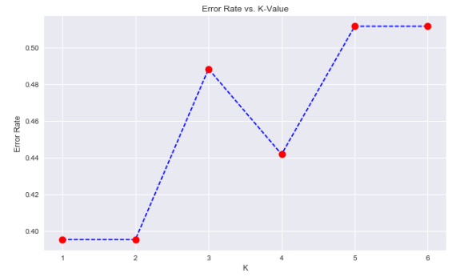
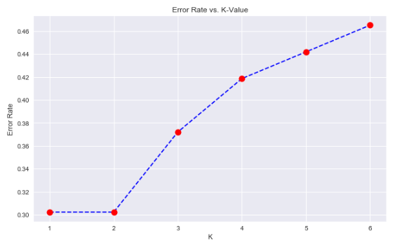
KNN | TS K-Neighbors Approach
Hand-labeled classes are used as an approximation to ground truth
The elbow-method identified a best value for K (1 or 2) consistent with research findings in the field of time series data mining
For comparison, a time-series implementation called K-Neighbors is also applied to allow use of the DTW distance metric
A random permutation cross-validator was used to split the data into train and test sets
KNN Elbow Method
TS K-Neighbors Elbow Method

Slide 11
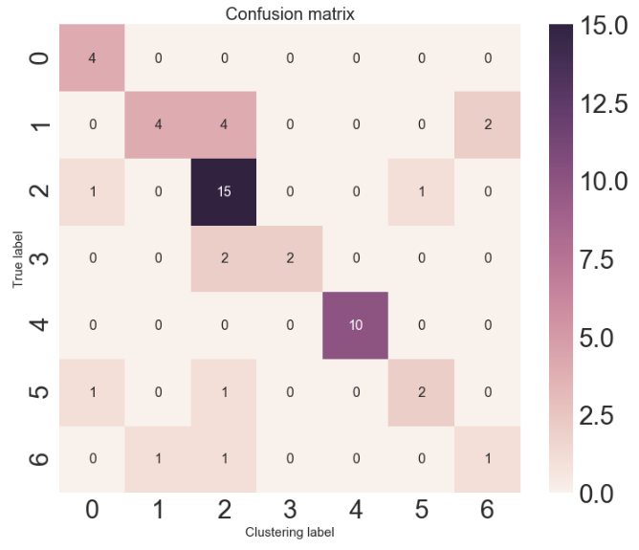
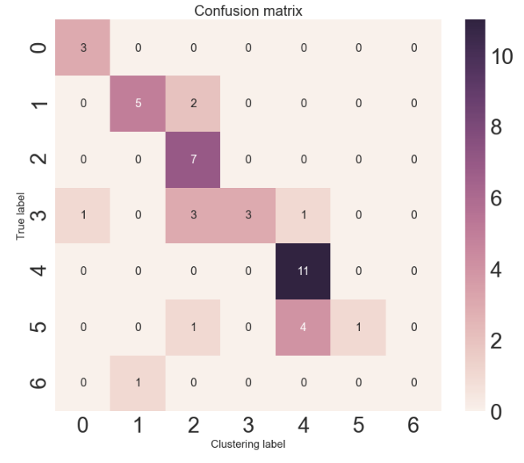
KNN | TS K-Neighbors Results
KNN: Ball-Trees and KD-Trees were used with Euclidean, Brute-Force, and Minkowski metrics
The most performant combination used the Ball-Tree and Minkowski metric:
TS K-Neighbors: used the DTW metric
(Subset) Accuracy – (Did we get it right?) – 0.73 (KNN), 0.70 (K-Neighbors)
Precision – (Did we get it all?) – 0.76 (KNN), 0.78 (K-Neighbors)
Recall – (Did we only get what we were supposed to?) – 0.73 (KNN), 0.70 (K-Neighbors)
F1-Score – (Weighted average of Precision | Recall) – 0.72 (KNN), 0.65 (K-Neighbors)
NMI [0, 1] – (Scales Mutual Information from 0 to 1) – 0.63 (KNN), 0.64 (K-Neighbors)
AMI (~0, 1] – (Adjustment of NMI, accounting for chance) – 0.50 (KNN), 0.48 (K-Neighbors)
Adjusted-Rand [-1, 1] – (Similarity metric considering all sample pair assignments) – 0.49 (KNN), 0.45 (K-Neighbors)
Homogeneity [0, 1] – (Do the clusters contain only a single class?) – 0.60 (KNN), 0.58 (K-Neighbors)
Completeness [0, 1] – (Are all data points of a given class in the same cluster?) – 0.66 (KNN), 0.70 (K-Neighbors)
V-Measure [0, 1] – (Harmonic mean of Homogeneity and Completeness) – 0.63 (KNN), 0.63 (K-neighbors)
KNN Confusion Heatmap
TS K-Neighbors Heatmap

Slide 12
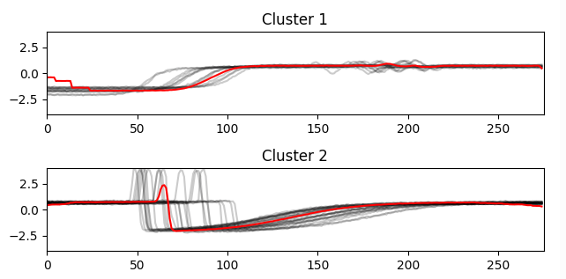
K-Shape Approach
K-Shape preserves the shapes of compared sequences using a parameter-free, scale- and shift-invariant distance metric based on cross-correlation values of timesteps
The normalized cross-correlation measure can handle distortions in amplitude and phase when computing time series cluster centroids
Mean-variance scaling (mu = 0, sigma = 1) is performed before model fitting
Example from the Python TSLearn Documentation

Slide 13
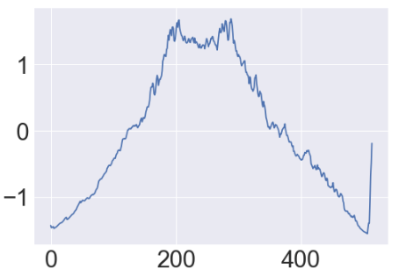
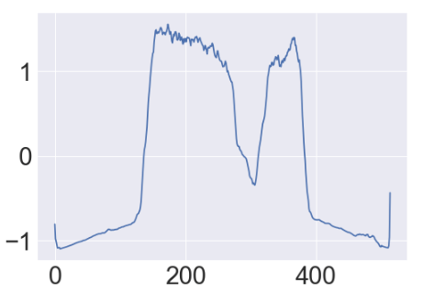
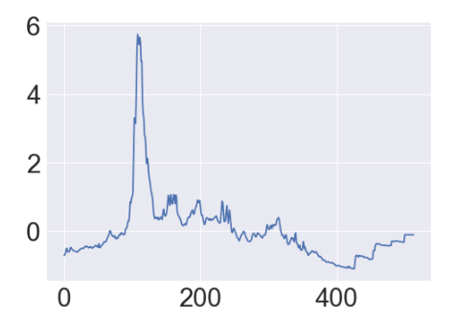
K-Shape Results
Using Euclidean, Cosine, Minkowski, DTW & Soft-DTW metrics:
Inertia: the sum of the distances of samples to their closest cluster center
Lower is better
0.03 (DTW)
Silhouette Scores: difference between the mean intra-cluster distance and the mean nearest-cluster distance for each sample, divided by the maximum of the two
[-1, 1]: Closer to 1 is better
0.26 (Cosine)
Calinski-Harabaz Scores: ratio between within-cluster & between-cluster dispersion
Higher is better
26.52 (DTW)
Partially Cloudy Centroid
Sunny with Occlusion Centroid
Cloudy with Sun-spike Centroid

Slide 14
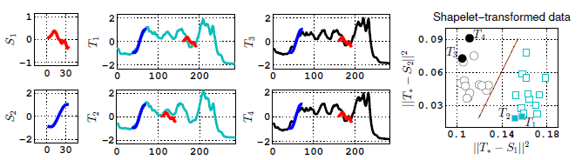
Shapelet Classification Approach
Inter-class differences between time series may occur on the scale of sub-sequences, rather than overall structure
Shapelet classifiers learn maximally discriminative time series sub-sequences
Distances between series and shapelets represent shapelet-transformed classification features whose segregation properties (Information Gain, F-Stat, Kruskall-Wallis) are used to optimize the objective function
Example of shapelet-series distances projected to a 2D-space

Slide 15
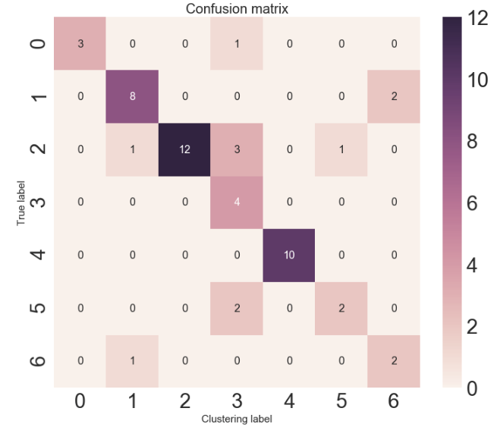
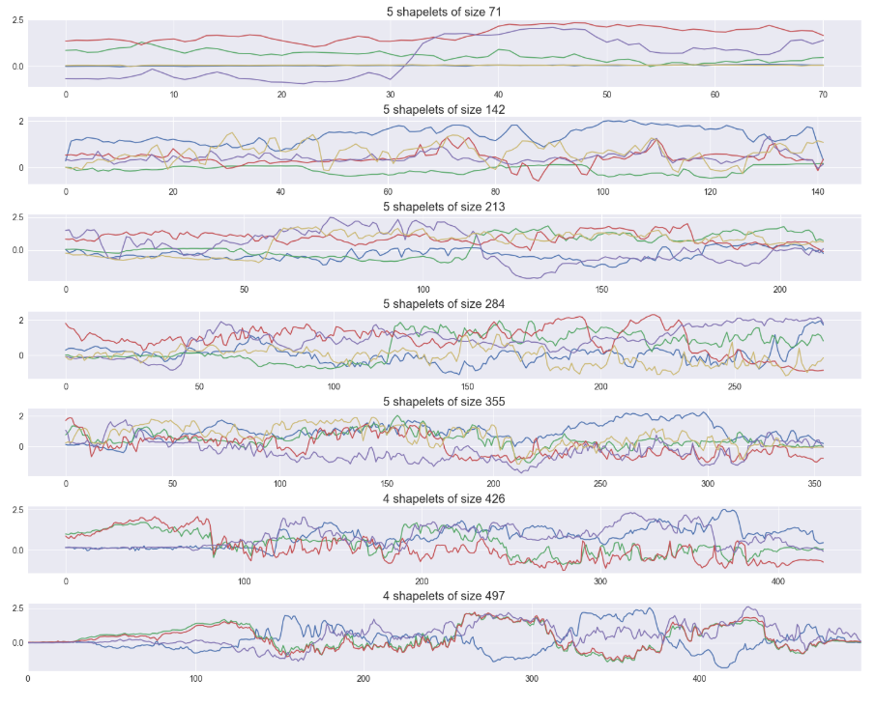
Shapelet Classification Results
Min-Max scaling [0, 1] was performed and a random permutation cross-validator was used to split the data into train and test sets
The most performant configuration used the RMSProp optimizer and 7 different shapelet lengths with a baseline segment length of 14% (71) of the total number of timesteps (514)
(Subset) Accuracy – (Did we get it right?) – 0.79
Precision – (Did we get it all?) – 0.86
Recall – (Did we only get what we were supposed to?) – 0.79
F1-Score – (Weighted average of Precision | Recall) – 0.80
NMI [0, 1] – (Scales Mutual Information from 0 to 1) – 0.73
AMI (~0, 1] – (Adjustment of NMI, accounting for chance) – 0.64
Adjusted-Rand [-1, 1] – (Similarity metric considering all sample pair assignments) – 0.61
Homogeneity [0, 1] – (Do the clusters contain only a single class?) – 0.74
Completeness [0, 1] – (Are all data points of a given class in the same cluster?) – 0.71
V-Measure [0, 1] – (Harmonic mean of Homogeneity and Completeness) – 0.73
Shapelet Confusion Heatmap
Learned Shapelet Lengths

Slide 16
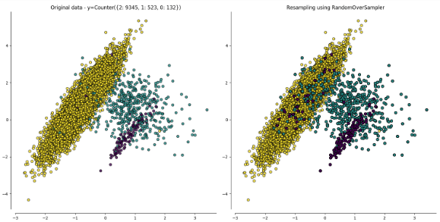
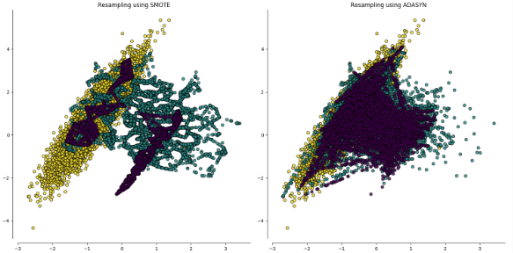
Shapelet Classifier with Oversampling
To improve performance of the Shapelet Classifier, the Synthetic Minority Oversampling Technique (SMOTE) and the Adaptive Synthetic Sampling approach (ADASYN) were used to oversample classes with fewer instances from which to learn
During resampling, SMOTE uses borderline data points or SVMs to select or create new samples
In synthesizing new data, ADASYN uses a nearest-neighbors rule, weighting minority class examples to adaptively shift the classification decision boundary toward more difficult examples
Although neither strategy improved Accuracy, Precision, Recall, F-1 Score, or the Adjusted-Rand Index, the ADASYN approach did result in improvements in:
NMI [0, 1] – (Scales Mutual Information from 0 to 1) – 0.74 (ADASYN), 0.73 (unbalanced)
AMI (~0, 1] – (Adjustment of NMI, accounting for chance) – 0.65 (ADASYN), 0.64 (unbalanced)
Homogeneity [0, 1] – (Do the clusters contain only a single class?) – 0.75 (ADASYN), 0.74 (unbalanced)
Completeness [0, 1] – (All data of a given class in the same cluster?) – 0.73 (ADASYN), 0.71 (unbalanced)
V-Measure [0, 1] – (Harmonic mean of Homogeneity and Completeness) – 0.74 (ADASYN), 0.73 (unbalanced)
Example from the Python Imbalanced-Learn Documentation

Slide 17
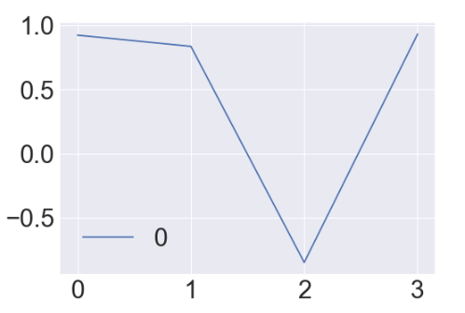
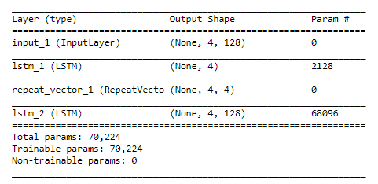
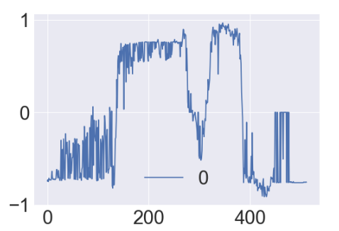
LSTM Seq-2-Seq Autoencoder Approach
Unlike densely-connected Stacked Autoencoders and Restricted Boltzmann Machines, recurrent sequence-to-sequence (Seq-2-Seq) autoencoders explicitly account for time series sequentiality
An LSTM Seq-2-Seq Autoencoder was used to perform unsupervised representation learning, projecting time series to a fixed-length (4, ) lower dimensional space
The learned representations identified during pretraining were input as features to the other unsupervised approaches used
Encoded Output at Intermediate Layer
LSTM Seq-2-Seq Autoencoder Model Summary
Decoding Reconstruction

Slide 18
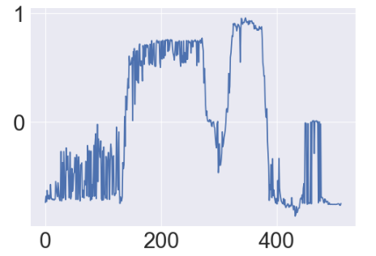
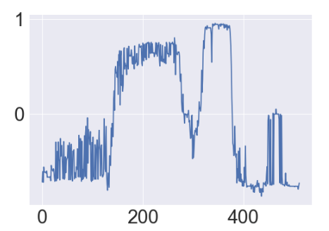
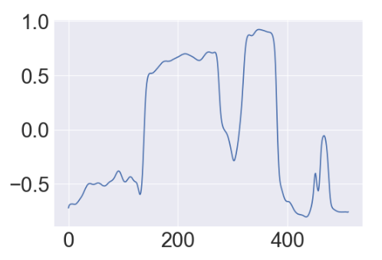
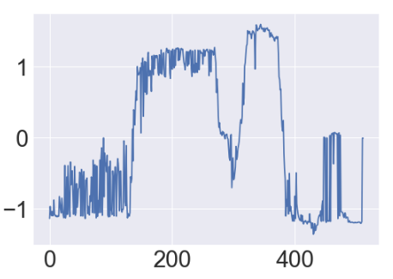
LSTM Seq-2-Seq Autoencoder Results
The same algorithms and metrics as before were applied in clustering the LSTM Autoencoded Sequences using the K-Means++, DTW and Soft-DTW Time Series K-Means, and K-Shape approaches
Using the encoded sequences resulted in improvements in:
Inertia: the sum of the distances of samples to their closest cluster center
Lower is better
0.0076 (K-Shape), 0.029 (unencoded), 1.073 (DTW K-Means), 1764.23 (K-Means++)
Silhouette Scores: difference between the mean intra-cluster distance and the mean nearest-cluster distance for each sample, divided by the maximum of the two
[-1, 1]: Closer to 1 is better
0.59 (K-Means++), 0.22 (unencoded), 0.26 (K-Shape), 0.19 (Soft-DTW K-Means)
Calinski-Harabaz Scores: ratio between within-cluster & between-cluster dispersion
Higher is better
116.24 (K-Means++), 42.56 (unencoded), 26.52 (K-Shape), 41.03 (Soft-DTW K-Means)
LSTM Encoded K-Means++
LSTM Encoded DTW K-Means
LSTM Encoded Soft-DTW K-Means
LSTM Encoded K-Shape

Slide 19
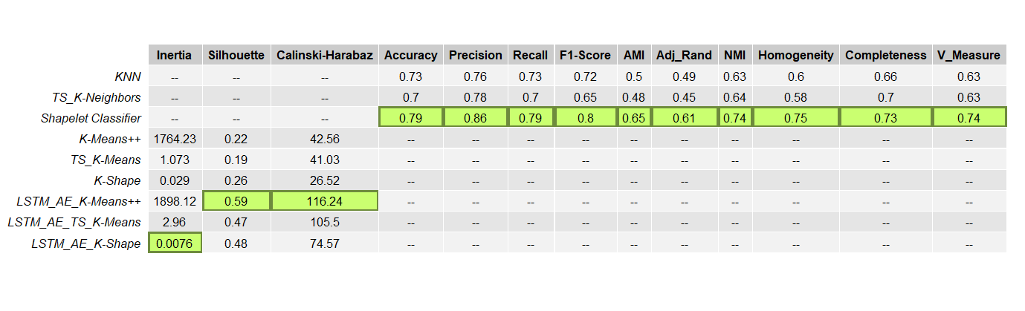
Results Summary
Amongst supervised methods, the Shapelet Classifier was most performant across all metrics.
Furthermore, applying ADASYN oversampling improved AMI, NMI, Homogeneity, Completeness, and V-Measure scores
Amongst unsupervised methods, using the LSTM Sequence-to-Sequence Autoencoder to perform unsupervised representation learning in a pretraining module improved the Silhouette and Calinski-Harabaz metrics of all algorithms to which it was applied

Slide 20
Key Insights
The high performance of the Shapelet Classifier suggests that sub-sequences are more informative than overall shape in discriminating between different radiation profiles
As mentioned in Grabocka, et. al. (2014), interpretable shapelets have been used to enable early classification of time series
This quality is readily applicable to the radiation-level forecasting use case
While supervised approaches were robust enough to learn from a relatively small data set with hand-labeled classes, the classes identified by unsupervised methods did not completely align with those identified using domain knowledge
Use of the highly performant LSTM Sequence-to-Sequence representation learning strategy distinguished between two forms of ‘Mixed Sunny and Partially Cloudy’ classes, one of which has maximum sensor values that peak early (Sunny-to-Partially Cloudy), the other of which peaks late in the day (Partially Cloudy-to-Sunny)
All unsupervised approaches also deprioritized the distinction between ‘Sunny’ and ‘Sunny with Occlusion’ in favor of other patterns, less readily identified when applying domain knowledge unassisted by machine learning

Slide 21
References
Kasetty, S., Stafford, C., Walker, G., Wang, X. and Keogh, E. (2008). Real-Time Classification of Streaming Sensor Data. In: Tools with Artificial Intelligence, ICTAI '08. IEEE.
Lin, J., Williamson, S., Borne, K., and DeBarr, D. (2012). Pattern Recognition in Time Series. In: Advances in Machine Learning and Data Mining for Astronomy. New York: Chapman & Hall, CRC Press, 1-28.
Mitsa, T. (2010). Temporal Data Mining. 1st ed. New York: Chapman & Hall, CRC Press.
Nishida, T. and Mohammad, Y. (2015). Mining Time-Series Data. In: T. Nishida and Y. Mohammad, ed., Data Mining for Social Robotics: Toward Autonomously Social Robots. New York: Springer, 35-83.
Seto, S., Zhang, W. and Zhou, Y. (2015). Multivariate Time Series Classification Using Dynamic Time Warping Template Selection for Human Activity Recognition. In: 2015 IEEE Symposium Series on Computational Intelligence (SSCI). IEEE Xplore.
Spiegel, S., Gaebler, J., Lommatzsch, A., De Luca, E. and Albayrak, S. (2011). Pattern recognition and classification for multivariate time series. In: Fifth International Workshop on Knowledge Discovery from Sensor Data. New York: Association for Computing Machinery.
Keogh, E., Chakrabarti, K., Pazzani, M. et al. Dimensionality Reduction for Fast Similarity Search in Large Time Series Databases. In: Knowledge and Information Systems (2001) 3: 263. https://doi.org/10.1007/PL00011669.
Keogh, E. and Ratanamahatana, C. Exact indexing of dynamic time warping. In: Knowledge and Information Systems (2005) 7: 358. https://doi.org/10.1007/s10115-004-0154-9.
Petitjean F., Ketterlin, A., and Gancarski, P. (2011). A global averaging method for dynamic time warping, with applications to clustering. In: Pattern Recognition. 44(3). 678-693.
Blondel, M. and Cuturi, M. (2018). Soft-DTW: a Differentiable Loss Function for Time-Series. In: Proceedings of the 34th International Conference on Machine Learning. Sydney, Australia. PMLR 70, arXiv:1703.01541v2.
Rousseeuw, P. (1986). Silhouettes: a Graphical Aid to the Interpretation and Validation of Cluster Analysis. In: Journal of Computational and Applied Mathematics. 20. 53-65.
Paparrizos J., and Gravano, L. (2015). K-Shape: Efficient and Accurate Clustering of Time Series. In: The ACM SIGMOD Record. 45(1). https://doi.org/10.1145/2949741.2949758.
Grabocka, J., Schilling, N., Wistuba, M., and Schmidt-Thieme, L. (2014). Learning Time-Series Shapelets. In: Proceedings of the 20th ACM SIGKDD International Conference on Knowledge Discovery and Data Mining. 392-401.
Chawla, N., Bowyer, K., Hall, L., and Kegelmeyer, W. (2002). SMOTE: Synthetic Minority Over-sampling Technique. In: Journal of Artificial Intelligence Research. 16. 321-357.
He, H., Bai, Y., Garcia, E., and Li, S. (2008). ADASYN: Adaptive Synthetic Sampling Approach for Imbalanced Learning. In: 2008 IEEE International Joint Conference on Neural networks. https://doi.org/10.1109/IJCNN.2008.4633969.
Amiriparian, S., Freitag, M., Cummins, N., and Schuller, B. (2017). Sequence to Sequence Autoencoders for Unsupervised Representation Learning from Audio. In: Detection and Classification of Acoustic Scenes and Events. Munich, Germany.
Arthur D. and Vassilvitskii S. (2007). K-Means++: the Advantages of Careful Seeding. In: SODA ‘07 Proceedings of the 18th annual ACM-SIAM Symposium on Discrete Algorithms. New Orleans, USA. 1027-1035.
Caliński T. and Harabasz J. (1974). A Dendrite Method for Cluster Analysis, In: Communications in Statistics, 3:1, 1-27, https://doi.org/10.1080/03610927408827101.
Cho, K., van M., B., Gulcehre, C., Bahdanau, D., Bougares, F., Schwenk, H., and Bengio, Y. (2014). Learning Phrase Representations using RNN Encoder-Decoder for Statistical Machine Translation. In: Proceedings of the 2014 Conference on Empirical Methods in Natural Language Processing (EMNLP). Doha, Qatar. 1724-1734, arXiv:1406.1078v3.

